Slide 1
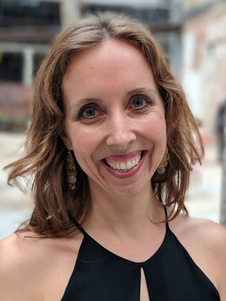
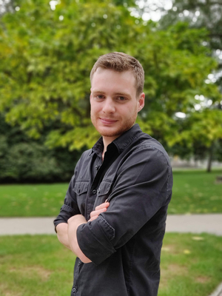
Arts and Sciences Digital Accessibility
Meet college representatives for Digital Accessibility
Eva Dale (dale.36@osu.edu)
Chris Wallace (wallace.638@osu.edu)
What the ADA office is looking for
Testing Software and Websites
Captions for Video
Skills Training
Questions/Accessibility Requests

Slide 2

Resources
ASCTech Digital Accessibility Webpage
Digital Accessibility Information
Request Software to be Tested
ASCTech Ticket
Request Video to be Transcribed/Captioned
ASCTech Ticket
Take Skills Training
Office Document Accessibility Skills Training (5 hours)
ADA Complaint Process
If someone sends a complaint about not being able to access something because of an ADA disability, then we need to respond to them within 24 hours and give a solution in 5 business days.
asc-accessibility@osu.edu
Questions about Digital Accessibility
asc-accessibility@osu.edu

